Slide 1
Prediction on injury in car accidents

Slide 2
BackgrounD and Problem
According to WHO, the number of road traffic deaths rising steadily up to 1.35 million in 2016. It is the 8th leading cause of death, less likely to survive than AIDs.
Prevention is always better than cure. This project is to predict the injury in car accidents. This is concerned by drivers for the purchase of insurance as well as the insurance company to adjust the insurance premium and the claim. On top of those, minimize the injury is most important purpose.

Slide 3
Data Source
The data I will us is obtained from this class’s, provided by SDOT Traffic Management Division, Traffic Records Group, from 2004 to Present. The dataset comes with many factors that may affect the probability of accidents: Geographic data, accident details, timestamp, road types at which accident happened like intersection, driver behavior, weather, road condition, light condition.

Slide 4
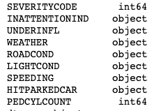
Data cleaning and Feature selection
There were 194673 samples and 38 features in the data.
I picked road types at which accident happened, driver behavior, weather, road condition, light condition.
1)Severity code is the prediction group, ​
2)inattentionind is the driver attention status, ​
3) underinfl is the status that driver is involved in drugs and alcohol ​
4) Weather, road and Light condition ​
5) whether the driver was speeding during the accident ​
6) hitparkedcar is whether the accident happened in car park ​
7) pedcylcount is whether bicycle involved in the accident ​

Slide 5
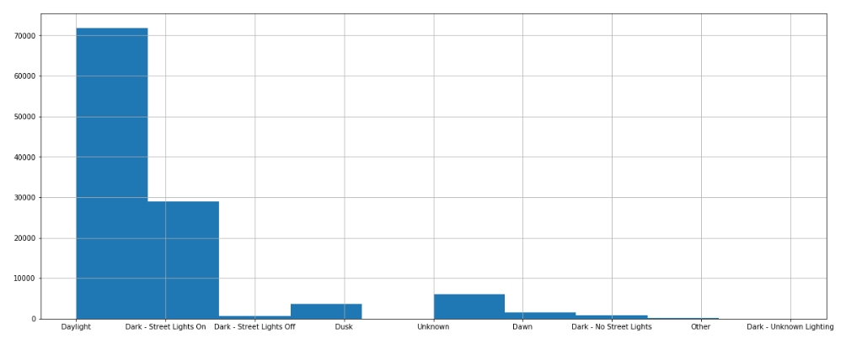
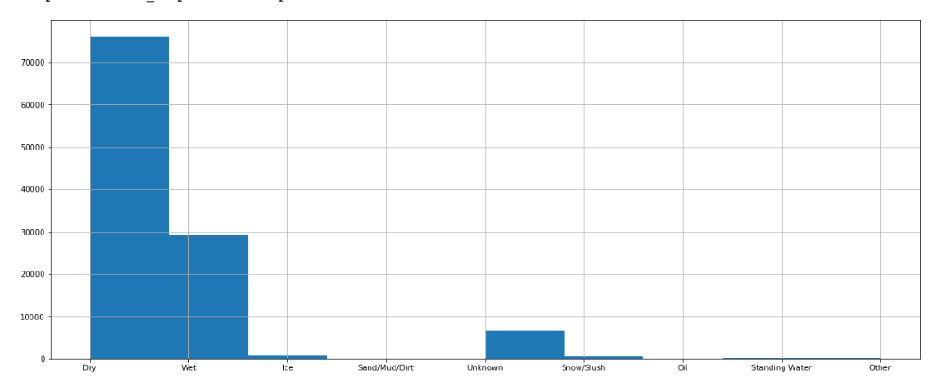
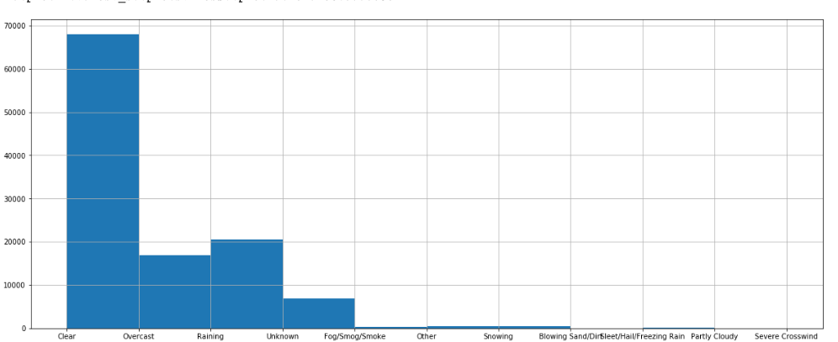
Data understanding and visualization
Prediction group is not balanced
All other categorical data needed to be converted to 1 or 0 and made dummy variables to train
Weather Road cond Light cond

Slide 6
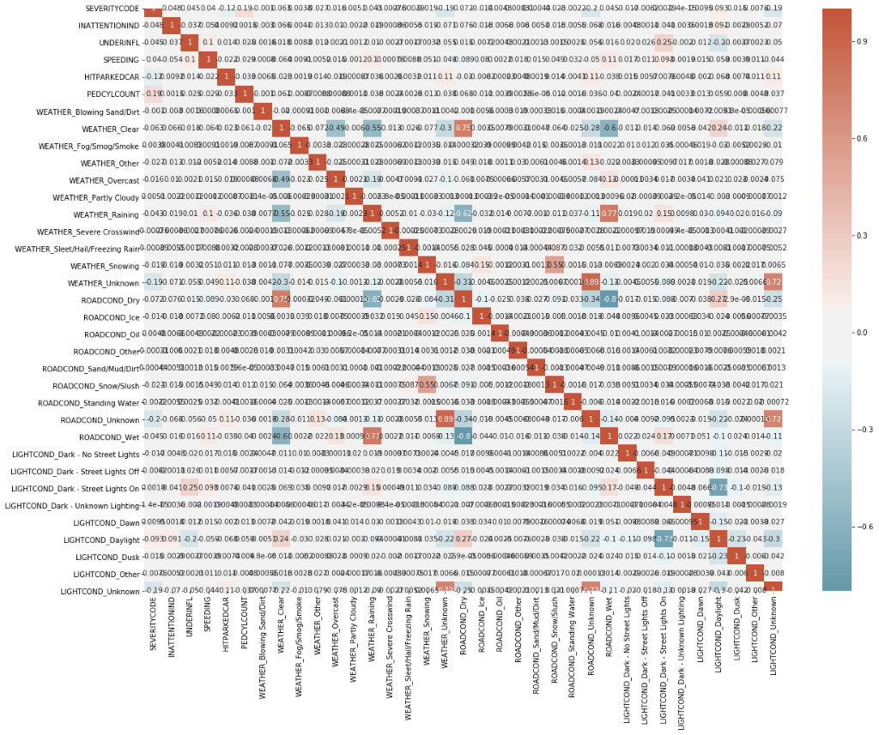
Removed some highly correlated features the model is better to train

Slide 7
Modeling and results
 | Decision Tree | KNN | Logistic Regression
Jaccard score | 0.51 | 0.36 | NA
F1 score | 0.41 | 0.56 | NA
Log loss | NA | NA | 0.64
Models to be used:
Decision Tree (best at d=1)
KNN (best at k=10)
Logistic Regression (best at C=0.01)

Slide 8
Discussion and Conclusion
Models have room to improve
More data or alternative datasets will be tested in the future.

